Slide 1

Decoding the Case Study Key Steps to Effectively Solve
Amul Desai
Program Head – Business Analytics
N. L. Dalmia Institute of Management Studies and Research
M: +91-98200 11456 | B: (022) 4299 0033
E: amul.desai@nldalmia.edu.in

Slide 2

Today’s Workshop Roadmap
Example Case: Uncovering Hidden Opportunity in Data
Defining the Objective
Gathering the Data
Preparing the Data
Preparing the Variables
Building the Model
Validating the Model
Implementing the Model
Maintaining the Model

Slide 3

Defining the Objective
What Is Your Business Goal?

Slide 4
What Is Your Business Goal?
Attract new customers?
Avoid high-risk customers?
Understand the characteristics of your current customers?
Make unprofitable customers more profitable?
Retain profitable customers?
Win back lost customers?
Improve customer satisfaction?
Increase sales?
continued...

Slide 5
What Is Your Business Goal?
Identify what products or services to bundle?
Reduce expenses?
Optimize campaigns to find highest value prospects?
Determine the most effective channel or sequence of channels?
Deliver the right message to the right person at the right time using the right channel?

Slide 6
The Customer Life Cycle – Modeling Opportunities
Former Customer
Prospect
New Customer
Established Customer
Response
Up-sell
Activation
Revenue
Cross-sell
Profit
Win
Back
Prospect
Lifetime
Value
Profit
Customer
Lifetime
Value
Cost
Risk
Loss
Risk
Retention
Collection
Risk
Collection

Slide 7


Response
Most common first model
Works for all direct channels
Mail
Phone
E-mail

Slide 8
Response Models
Insurance
Credit cards
Other financial products
Investments
Mortgages
Travel
Pharmaceuticals
Publishers
Magazines
Newspapers
Telecommunications
Local
Long distance
Mobile
Energy
Electric
Gas
Non-profits
Environmental
Political
Relief organizations

Slide 9
Risk Management
Default
Bank Loan
Credit Card
Equipment Loan
Line of Credit
Insurance Claim
Life
Auto
Home
Health
Fraud
Credit Card
Insurance Claim

Slide 10

Retention/Attrition/Churn
The flip side of customer loyalty
Huge focus for many businesses
Much less expensive to retain current customers than to acquire new customers
Various types
Voluntary churn
Forced churn
Silent churn

Slide 11
Basic Methodologies
Profiling & Segmentation
Penetration Analysis
Cluster Analysis
Linear regression
Logistic regression
Classification trees

Slide 12
Penetration Analysis
Age Group | Customer Base | Percent of File | Total Market | Percent of File
< 30 | 725 | 0.5% | 717,062 | 6.1%
30-34 | 3,445 | 2.3% | 987,464 | 8.4%
35-39 | 10,440 | 7.0% | 1,341,725 | 11.4%
40-44 | 11,795 | 7.9% | 2,084,676 | 17.7%
45-49 | 15,005 | 10.1% | 1,900,779 | 16.1%
50-54 | 23,435 | 15.7% | 1,726,869 | 14.7%
55-64 | 30,765 | 20.6% | 1,631,835 | 13.8%
65+ | 53,610 | 35.9% | 1,390,410 | 11.8%
Frequency of Age Groups

Slide 13
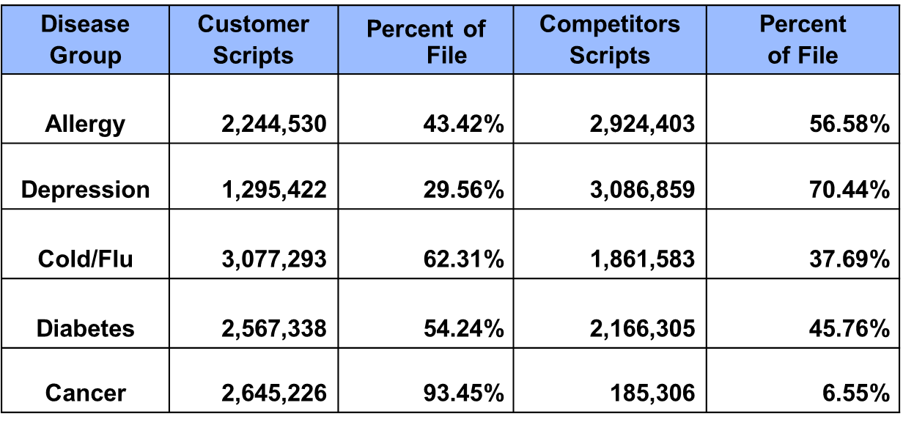
Penetration Analysis
Share of Wallet for Pharma Company

Slide 14
Behavioral Segmentation – Market Driven
Consummate Customers
Risky Revenue
Average Revenues ₹ 652
Risk Score 718
Age 43 Years
Length of Residence 87 Months
Number of Children 1.95
Income (000) 52
Percent Male 55%
Average Revenues ₹ 643
Risk Score 570
Age 34 Years
Length of Residence 55 Months
Number of Children 2.11
Income (000) 45
Percent Male 49%
R
E
V
E
N
U
E
S
Business Builders
Balance Bombs
Average Revenues ₹ 49
Risk Score 739
Age 48 Years
Length of Residence 78 Months
Number of Children 1.97
Income (000) 52
Percent Male 50%
Average Revenues ₹ 59
Risk Score 570
Age 32 Years
Length of Residence 40 Months
Number of Children 2.13
Income (000) 41
Percent Male 46%
RISK

Slide 15
Behavioral Segmentation – Market Driven
Consummate Customers
Risky Revenue
Best Customer Service
No Annual Fee
Automatic Line Increase
Offer Cardholder Benefits
Charge Annual Fee
Increase APR
Monitor Payment Behavior
Offer secured loan
R
E
V
E
N
U
E
S
Business Builders
Balance Bombs
Good Customer Service
Decrease APR
Offer Balance Transfers
Offer Cardholder Benefits
Charge Annual Fee
Increase APR
Low Priority Service
No Solicitations
RISK

Slide 16
Behavioral Segmentation – Data Driven Cluster Analysis
Three main clusters emerge
ccc

Slide 17
Simple Linear Regression
Advertising
120
160
205
210
225
230
290
315
375
390
440
475
490
550
Sales
1,503
1,755
2,971
1,682
3,497
1,998
4,528
2,937
3,622
4,402
3,844
4,470
5,492
4,398
6K
*
5K
*
*
*
*
S
A
L
E
S
4K
*
*
*
3K
*
*
2K
*
*
*
*
*
1K
0
0
100
200
300
400
500
600
ADVERTISING

Slide 18
Simple Linear Regression
Minimize Squared Error
6K
*
5K
*
*
*
S
A
L
E
S
*
4K
*
*
Goal: characterize relationship between advertising and sales
Result: equation that predicts sales based on advertising Rupees spent
*
3K
*
*
2K
*
*
*
*
*
1K
0
Sales = 866.59 + 7.81 * Advertising
0
100
200
300
400
500
600
ADVERTISING

Slide 19
Multiple Linear Regression
Minimizes squared error in N-dimensional space
Credit card balances
Payment amount
Age
*
*
*
*
*
*
*
Balances
*
*
*
*
*
*
*
Age
*
Payment Amount
CC Balances = 2.1774 + 9.4966*Payment + 1.2494*Age

Slide 20
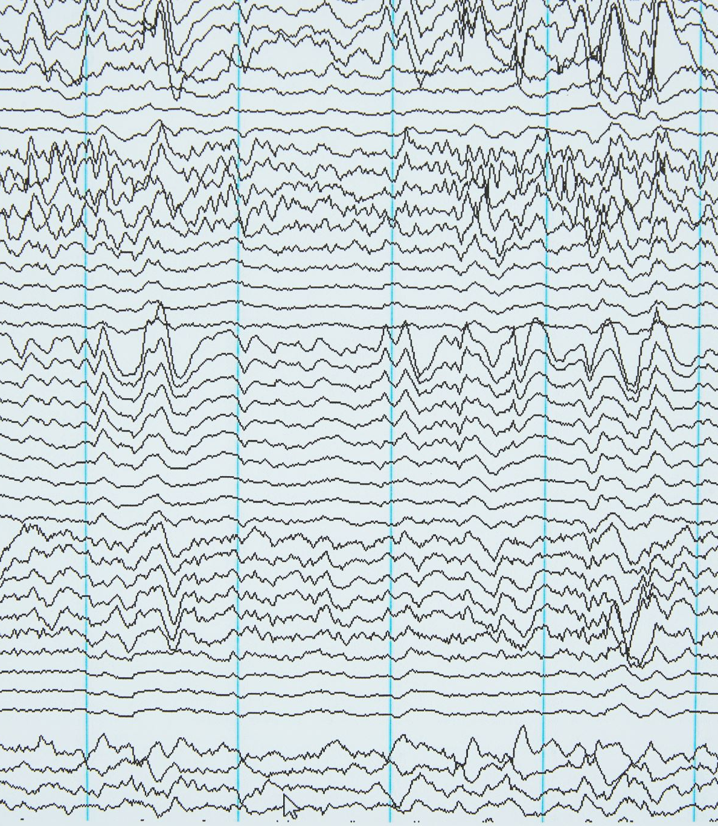
Linear Regression
Amount of sale ~ advertising, cost, demographics
Charge-off Rupees ~ balance, financial risk profile, demographics
Amount of claim ~ age, health risk profile, geography
Dollar balance ~ financial risk profile, action to account, market pressure
Average profitability ~ financial risk profile, price sensitivity, demographics
Minutes of use – telecommunications, internet

Slide 21
Logistic Regression
Predicts probability of event occurring using function of linear predictors
p = probability of event occurring
p/(1-p) is the odds of an event occurring.
Log of the odds:
log(p/(1-p)) is linear function of predictors.
1
* * * * * * * * * ** *** * ** * **** **
R
E
S
P
O
N
S
E
0
log(p/(1-p)) = B₀ + B₁X₁+ b₂X₂+…B_{n}X_{n}
P = 1/(1+e^{-(B0 + B1X1+ b2X2+…BnXn)})
**** ** ** *** * * * * * * *

Slide 22
Logistic Regression
Response to loan offer ~ financial risk profile, demographics
Response to insurance offer ~ health risk profile, demographics
Response ~ financial risk profile, demographics, market pressure
Charge-off ~ balance, financial risk profile, demographics
Claim ~ health risk profile, demographics
Fraud ~ financial risk profile, account activity
Account closure ~ account activity, market pressure

Slide 23
Classification Trees
Mailed 10,000
Resp Rate 2.6%
Male 4,677
Resp Rate 3.2%
Female 5,323
Resp Rate 2.1%
>45K 1,281
Resp Rate 4.1%
Age => 40 2,211
Resp Rate 4.3%
<30K 1,290
Resp Rate 1.7%
30K-45K 2,106
Resp Rate 3.6%
Age < 40 3,112
Resp Rate 0.7%

Slide 24
Gathering the Data
Creating A Modeling Dataset

Slide 25
Data Deluge

Slide 26
General Timeline for Model Data
Current Snapshot
File Pulled
Action
Taken
Response/Target Group
Matched to Historical Data
Historical/Static
Data Captured
Performance
Window
Model
Developed
New Data
Scored
Processing
Window
Average Time Range
Post/Mail: 3 – 12 months
TeleMktg: 1 – 14 days
Internet: 0 – 7 days

Slide 27
Response Model Same Product to the Same List Using a Prior Campaign
January:
mail file selected
Campaign mailed:
January
Responses: Feb. – Apr.
matched to mail file
Logistic model
developed
ABC Bank
prob = exp(b₀ + b₁X₁)
(1 + exp(b₀ + b₁X₁)
Mail File
Income
Mail File: 100,000
Random Selection of
Consumer File
30,000
11.9% APR
25,000
No Annual
Fee
1%
20,000
15,000
10,000
Numbers of People
5,000
-
< 10K
10-20K
20-30K
Income Ranges
30-40K
40-50K
50-60K
60-70K
70K+
Experian Credit Bureau
consumer file
Responders
300 demographic
and credit variables
Campaign mailed:
June
Campaign evaluated:
September
Logistic model used to score names from same file
Model scored: May
ABC Bank
Mail File
Mail File:
Names selected
by model
Mail File
11.9% APR
2.3%
No Annual
Fee
2.3%
Experian Credit Bureau
consumer file
Responders

Slide 28
‘Look Alike’ Model Similar Product to New List with No Prior Campaign
Modeling file selected
“Look-alike” logistic
model developed
Model used to
score list
prob = exp(b₀ + b₁X₁)
(1 + exp(b₀ + b₁X₁)
Income
30,000
25,000
20,000
20,000 sample
of nonpurchasers of
exercise equipment
2,500 purchasers of
exercise equipment
15,000
10,000
Numbers of People
5,000
-
< 10K
10-20K
20-30K
30-40K
40-50K
50-60K
60-70K
70K+
35 attributes
Life-style List Company
Campaign mailed
Campaign evaluated
Healthnut
Fitness
Mail File
Mail File
Names selected using
“look-alike” model
Spring
2.3%
3.1%
Life-style List Company
Responders

Slide 29
Model to Predict Up-sell and/or Cross Sell
Customer names selected
Email sent to
prospects
Email campaign
XYZ Life
Sample of
Customers
1.5%
Whole Life
Response matched
to mail file
Lifetime List Company
Logistic model used to
score new list
New campaign
Logistic model
developed
Email campaign
probability =
1/(1 + e^{-(b}0 ^{+ b}1^{X}1 ⁺ ^{+ b}2^{X}2⁾ )
Best scoring
Names selected
By model
Income
30,000
25,000
20,000
15,000
10,000
Numbers of People
5,000
-
< 10K
10-20K
20-30K
30-40K
40-50K
50-60K
60-70K
70K+
Lifetime List Company

Slide 30
Model to Predict Attrition or Churn
Data Stacking
Is used
Names and attributes
27-4 months prior
Names and attributes
24-1 months prior
Customer
Records
Go back
3 months
Customer
Records
0 Balance
Dependent
Variable
Customer file > 500 balance
Customer file
Take retention
action
Logistic model
developed
Logistic model used
to score and rank
customer or prospect file
Decile analysis
probability =
1/(1 + e^{-(b}0 ^{+ b}1^{X}1 ⁺ ^{+ b}2^{X}2⁾ )
Income
30,000
25,000
Rate
Reduction
20,000
15,000
10,000
Numbers of People
5,000
-
< 10K
10-20K
20-30K
30-40K
40-50K
50-60K
60-70K
70K+
Behavioral data
Determine who might
move balances

Slide 31
Credit Risk Model to Predict Bankruptcy
Logistic model
developed to predict bankruptcy
Names and attributes
4 years prior
Current names with bankruptcies
matched to archive file
Current Snapshot
probability =
1/(1 + e^{-(b}0 ^{+ b}1^{X}1 ⁺ ^{+ b}2^{X}2⁾ )
Archive File
Income
Go back
4 years
30,000
25,000
20,000
15,000
10,000
Bankruptcy
Numbers of People
5,000
-
< 10K
10-20K
20-30K
30-40K
40-50K
50-60K
60-70K
70K+
350 demographic
and credit variables
Experian Credit Bureau
Experian Credit Bureau
Logistic model used
to score and rank
customer or prospect file
Decile analysis
Campaign mailed to
low risk prospects
High Street
Bank
5.9%
No Fee
Prospect file

Slide 32
Risk Model to Predict Insurance Claims
Names and attributes
5-10 years prior
Current names with claims
matched to archive file
Logistic model
developed
Go back
5-10 years
Customer Records
Current Snapshot
probability =
1/(1 + e^{-(b}0 ^{+ b}1^{X}1 ⁺ ^{+ b}2^{X}2⁾ )
Claims
Income
30,000
25,000
20,000
15,000
10,000
Numbers of People
5,000
-
< 10K
10-20K
20-30K
30-40K
40-50K
50-60K
60-70K
70K+
Sure Hit Demographics
psychographic, segments
Customer file
Customer file
Logistic model used
to score and rank
customer or prospect file
Decile analysis
Issue policy
Determine risk cut-off

Slide 33
Model to Predict Fraud
Typical Purchase
Neural net model
continually updated
Transaction record
Atypical Purchase
Used to score and rank
customer or prospect file
2.3%
Customer contact

Slide 34

Data Characteristics
Demographic
Behavioral
Psychographic
Individual
Family
Geographic
Zip level
Block group
 | Power | Stability | Cost
Demographic | Med | High | Low
Behavioral | High | Low | High
Psychographic | Med | Low/High | High

Slide 35

Internal Sources
Customer Database
Transaction Database
Offer History Database
Solicitation Mail and Phone Tapes
Data Warehouse

Slide 36

Customer Database
Customer ID
Household ID
Account number
Customer name
Address
Phone number
Demographics
Products or services
Offer detail
Model scores

Slide 37

Transaction Database
Customer ID
Account Number
Activity Type
Activity Amount
Activity Date

Slide 38

Offer History Database
Prospect ID/Customer ID
Household ID
Prospect name
Address
Phone number
Offer detail
Offer summary
Model scores
Predictive data

Slide 39


Solicitation E-Mail and Phone Calls
Customer or prospect ID
Predictive data
Demographic
Behavioral
Psychographic

Slide 40
Data Warehouse
End Users
End Users
Scored
Names
Data
Mart
Central
Data
Repository
Data
Mart
Transactions
Meta Data
Data
Mart
Offer
History
End Users
Customer
Data

Slide 41
Preparing the Data
Sampling, cleaning and transforming the data

Slide 42
Sampling Designs
00001000011001000000
00010001000010001000
10001000000100000010
00000010101000000101
00000010000001000000
0000000000000000
0000000000000000
0000000000000000
0000000000000000
0000000000000000
11
11
11
11
11
Joint
Separate
00001000010
10010000000
01101001010
10010011100
Where 0 = non-target
and 1 = target

Slide 43

Exploratory Data Analysis
Outliers
Missing Values
Statistics
means
univariate
Freq
Charts/Graphs

Slide 44
Outliers
Outliers are observations with extreme values for one or more variables.
Data error
Uncommon characteristic

Slide 45
Missing Values
Missing values are observations with no meaningful value.
Error
Nonmatch

Slide 46
Univariate Analysis
Weighted Quantiles
Quantile | Estimate
100% Max | 92
99% | 79
95% | 62
90% | 54
75% Q3 | 43
50% Median | 32
25% Q1 | 24
10% | 21
5% | 20
1% | 19
0% Min | 1
Weighted Moments
N | 44294 | Sum Weights | 173624
Mean | 35.1009365 | Sum Observations | 6094365
Std Deviation | 13.6314467 | Variance | 185.816339
Skewness | . | Kurtosis | .
Uncorrected SS | 246180095 | Corrected SS | 32262176.1
Coeff Variation | 38.8349943 | Std Error Mean | .
Extreme Observations
Lowest |  | Highest
Value | Obs | Value | Obs
1 | 22438 | 92 | 49309
1 | 17013 | 92 | 49474
2 | 4805 | 92 | 49604
3 | 50445 | 92 | 50125
4 | 36605 | 92 | 50344
Missing Values
Missing Value | Count | Percent Of
 |  | All Obs | Missing Obs
. | 6233 | 12.34 | 100.00

Slide 47
Univariate Analysis - Plots
Weighted Histogram # Boxplot
92.5+* 152 0
.* 465 0
.* 857 0
.** 1426 0
.** 1797 0
.*** 2760 |
.**** 3292 |
.****** 5737 |
.********* 8717 |
47.5+************* 12567 |
.***************** 16614 +-----+
.******************** 19666 | + |
.*********************** 22210 *-----*
.********************************* 32432 | |
.**************************************** 39823 +-----+
.****** 5103 |
. |
. |
2.5+* 6 |
----+----+----+----+----+----+----+----+
* may represent up to a weighted count of 1000

Slide 48
Handling Outliers
Analysis
Perform checks using your industry knowledge to see if the values look reasonable.
Remedies
Capping: define a value that is some multiple of the standard deviation or an nth of the population. Use that as the cap.
Deletion

Slide 49
Handling Missing Values
Remedies
Continuous Variables
Single value substitution
Class mean substitution
Regression substitution
Categorical Variables
Separate level
Collapsing
Deletion

Slide 50
Single Value Substitution
Weighted Moments
N | 44294 | Sum Weights | 173624
Mean | 35.1009365 | Sum Observations | 6094365
Std Deviation | 13.6314467 | Variance | 185.816339
Skewness | . | Kurtosis | .
Uncorrected SS | 246180095 | Corrected SS | 32262176.1
Coeff Variation | 38.8349943 | Std Error Mean | .
Weighted Quantiles
Quantile | Estimate
100% Max | 92
99% | 79
95% | 62
90% | 54
75% Q3 | 43
50% Median | 32
25% Q1 | 24
10% | 21
5% | 20
1% | 19
0% Min | 1
Use the mean or median

Slide 51
Class Means Substitution
Cluster analysis groups variables with like characteristics and find the mean within the cluster.
Example: Age using gender, marital status and age group.

Slide 52
Multiple Linear Regression
Predict age as a function of other age-related variables
*
*
*
*
*
*
*
*
Age
*
*
*
*
*
*
Age of File
*
Ave Months Acct Open
Age = 2.1774 + 9.4966*AveMths + 1.2494*Age File

Slide 53

Preparing the Variables
Fitting the predictive variables

Slide 54
Variable Reduction and Transformation
Continuous Variables
Binning or bucketing
Transformations
Categorical Variables
Dichotomization
Collapsing
Interactions

Slide 55
Goal: Linear Relationship
Minimize Squared Error
As sales increase, advertising increases in a linear pattern.
This creates a good fit for the model.
For logistic regression, the log of the odds is linear to the predictors.
6K
*
5K
*
*
*
S
A
L
E
S
*
4K
*
*
*
3K
*
*
2K
*
*
*
*
*
1K
0
0
100
200
300
400
500
600
ADVERTISING

Slide 56
Binning or Bucketing
Relationship
2K : advertising < 300
3.5K : 300 =< advertising < 400
2.5K : 400 =< advertising
6K
5K
S
A
L
E
S
4K
*
*
*
*
3K
*
*
Suggested Variables
B1 = (advertising < 300)
B2 = (300 =< advertising < 400)
B3 = (400 =< advertising)
Value is 1 if logic is true, otherwise 0.
*
*
*
2K
*
*
*
*
*
*
*
1K
0
0
100
200
300
400
500
600
ADVERTISING

Slide 57
Curvi-linear Transformations
Adver_Sq = Advertising ²
6K
*
*
*
*
*
5K
*
*
*
*
S
A
L
E
S
*
*
*
4K
*
*
*
3K
*
*
*
*
*
2K
*
*
*
*
*
*
*
1K
*
*
*
0
0
100
200
300
400
500
600
ADVERTISING

Slide 58
Creating Transformations
Finding transformations used to be laborious
Computer power allows us to test everything
Methodology
create some common transformations of each continuous candidate variable
combine with any indicator variables created in the previous step and run a regression model to see which form or forms fit the best

Slide 59
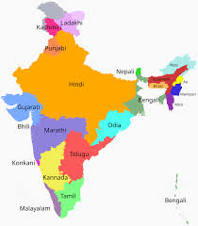
Categorical Variables
Categorical variables are powerful predictors.
Issue – logistic regression uses only continuous values
must redesign the variables to suit this form.
Solution – indicator variables
have a value of 1 if a condition is true and 0 otherwise.

Slide 60
Preparing the Variables: Categorical
Table of Active by Linguistic Region
Active | Regional Language |  |  |  | Total
Frequency Col Pct | Hindi | Tamil | Konkani | Telegu
0 | 16,800 96.60 | 22,600 96.93 | 12,080 96.12 | 29,890 97.11 | 81,370
1 | 592 3.40 | 716 3.07 | 487 3.88 | 889 2.89 | 2,684
Total | 17,392 | 23,316 | 12,567 | 30,779 | 84,054
Midwest and West have similar performance and can be grouped together

Slide 61
Preparing the Variables: Categorical
Indicator Variables → → | Hindi | Non-Hindi
Hindi | 1 | 0
Tamil | 0 | 0
Konkani | 0 | 0
Telegu | 0 | 0
Create two variables called “Hindi” and “Non-Hindi” with a value of ‘1’ if Regional Language = Hindi
Regional Language = ‘Tamil’, ‘Konkani’ and Telegu is the default to “zero”

Slide 62
Preparing the Variables: Interaction Detection
Classification
Tree
Total File
Resp Rate 3.9%
Male
Resp Rate 4.2%
Female
Resp Rate 2.9%
>45K
Resp Rate 5.6%
<30K
Resp Rate 1.7%
Age => 40
Resp Rate 4.8%
30K-45K
Resp Rate 4.9%
Age < 40
Resp Rate 0.7%

Slide 63

Preparing the Final Modeling Data Set
The variable transformation is complete.
Now we create a final modeling data set that contains only powerful candidate variables.
Let the fun begin!

Slide 64
Building the Model
Processing the logistic regression

Slide 65
Logistic Regression – My Favorite!
Uses continuous values to predict discrete outcome
Powerful
Robust
Easy
Selection Methods
Stepwise
Backward
Score

Slide 66

Stepwise Selection
Strongest predictive variable enters the model.
Each time a new variable enters the model, the individual predictive power of the remaining variables not in the model is recalculated.
Also, the multivariate chi-square or incremental predictive power of each predictive variable in the model is recalculated.
The main difference is that if any variable, newly entered or already in the model, becomes insignificant after it or another variable enters, it is removed.
Main disadvantage is slower processing time because each step considers every variable for entry or removal.

Slide 67
Backward Selection
Begins with all the variables in the model.
Each variable considered in conjunction with all other variables.
Removes any variable whose predictive power is insignificant, beginning with the most insignificant variable.
After each variable is removed, the multivariate chi-square for all variables still in the model is recalculated with one less variable. This continues until all remaining variables have multivariate significance.
Benefits: It allows variables with low individual (univariate) significance to be considered as a group for entry in the model.
The resulting model may depend on more equal contributions of many variables instead of the dominance of one or two very powerful variables.

Slide 68
Score Selection
Constructs models using all possible subsets of variables within the list of candidate variables using the highest likelihood score (chi-square) statistic.
Also known as the best subsets method.
Does not derive the model coefficients.
Simply lists the best variables for each model along with overall chi-square.

Slide 69
Model Output
p(active) = P = 1/(1+e^{-(B0 + B1X1+ b2X2+…BnXn)})
p(active) = exp(b₀ + b₁X₁ + b₂X₂ + … + b_{n}X_{n} )
(1 + exp(b₀ + b₁X₁ + b₂X₂ + … + b_{n}X_{n} )

Slide 70
Gains Table
 |  | Predicted | Percent | Cum | Number | % of Total | Cum # | Cum % of |  | Cum
Decile | Number | % Active | Active | % Active | of Actives | Actives | of Actives | Total Actives | Lift | Lift
1 | 9,855 | 2.60% | 2.29% | 2.29% | 226 | 25.08% | 226 | 25.08% | 251 | 251
2 | 9,864 | 1.59% | 1.57% | 1.93% | 155 | 17.20% | 381 | 42.29% | 172 | 211
3 | 9,856 | 1.19% | 1.14% | 1.67% | 112 | 12.43% | 493 | 54.72% | 124 | 182
4 | 9,862 | 0.95% | 0.95% | 1.49% | 94 | 10.43% | 587 | 65.15% | 104 | 163
5 | 9,859 | 0.79% | 0.69% | 1.33% | 68 | 7.55% | 655 | 72.70% | 75 | 145
6 | 9,858 | 0.67% | 0.68% | 1.22% | 67 | 7.44% | 722 | 80.13% | 74 | 134
7 | 9,853 | 0.57% | 0.58% | 1.13% | 57 | 6.33% | 779 | 86.46% | 63 | 124
8 | 9,857 | 0.50% | 0.53% | 1.05% | 52 | 5.77% | 831 | 92.23% | 58 | 115
9 | 9,865 | 0.42% | 0.43% | 0.98% | 42 | 4.66% | 873 | 96.89% | 47 | 108
10 | 9,862 | 0.33% | 0.28% | 0.91% | 28 | 3.11% | 901 | 100.00% | 31 | 100
TOT | 98,591 |  | 0.91% |  | 901 | 100.00%

Slide 71
Model Lift
Lift = model efficiency
It measures model performance versus random or average performance for a given depth of file.
Example: 25-variable model
At 30% of the file, using the model we capture (226 + 155 + 112) / 901 = 54.72% of the responders.
Lift = 54.72/30*100 = 182 or 54.72/30 = 1.82
We say that at 30% of the file the lift is 1.82. This is equivalent to saying that we get an 82% higher than average response rate at a 30% depth of file, or that the model does 1.82 times better than average at 30% depth of file.

Slide 72
Gains Chart

Slide 73

Validating the Model
How do we know if it really works?

Slide 74
Validating the Model
Scoring an alternate data set
Bootstrapping
Key variable analysis

Slide 75
Scoring an Alternate Data Set
Models often deteriorate when scored on a data set that was not used in model development.
A similar campaign from a different time period or geographic area is good for validation.

Slide 76
Scoring Validation Comparison

Slide 77
Bootstrapping
Validation technique that uses resampling.
Provides an empirical estimation based on experience and observation instead of a parametric estimation based on a system or distribution.
Detects over-fitting by using repeated samples to validate the results of a model.
Allows for confidence intervals around estimates to aid in campaign performance predictions.

Slide 78
Bootstrapping Output for Lift

Slide 79
Analysis on Key Variables
Managers and marketers want to know how the model is organizing the prospects.
They often know what factors should be driving their market.
Understanding the distribution with respect to the model can assure them that the model is performing the way they expect.

Slide 80
Analysis on Key Variables
Decile | Number of Prospects | Age | Male Y/N | Risk Score | Length of Residence
1 | 19,667 | 25 | 47.32% | 543 | 68
2 | 19,685 | 27 | 48.77% | 561 | 87
3 | 19,676 | 31 | 50.99% | 594 | 105
4 | 19,676 | 37 | 53.52% | 625 | 112
5 | 19,672 | 39 | 53.08% | 646 | 119
6 | 19,674 | 42 | 54.70% | 669 | 118
7 | 19,680 | 45 | 54.76% | 689 | 115
8 | 19,674 | 48 | 54.54% | 714 | 114
9 | 19,675 | 54 | 55.15% | 737 | 110
10 | 19,680 | 59 | 53.14% | 761 | 111
Total | 196,759 | 60 | 52.60% | 654 | 130

Slide 81

Implementing the Model
Ensuring the model is applied correctly

Slide 82
Model Selects
 |  | Predicted | Percent | Cum | Number | % of Total | Cum # | Cum % of |  | Cum
Decile | Number | % Active | Active | % Active | of Actives | Actives | of Actives | Total Actives | Lift | Lift
1 | 9,855 | 2.60% | 2.29% | 2.29% | 226 | 25.08% | 226 | 25.08% | 251 | 251
2 | 9,864 | 1.59% | 1.57% | 1.93% | 155 | 17.20% | 381 | 42.29% | 172 | 211
3 | 9,856 | 1.19% | 1.14% | 1.67% | 112 | 12.43% | 493 | 54.72% | 124 | 182
4 | 9,862 | 0.95% | 0.95% | 1.49% | 94 | 10.43% | 587 | 65.15% | 104 | 163
5 | 9,859 | 0.79% | 0.69% | 1.33% | 68 | 7.55% | 655 | 72.70% | 75 | 145
6 | 9,858 | 0.67% | 0.68% | 1.22% | 67 | 7.44% | 722 | 80.13% | 74 | 134
7 | 9,853 | 0.57% | 0.58% | 1.13% | 57 | 6.33% | 779 | 86.46% | 63 | 124
8 | 9,857 | 0.50% | 0.53% | 1.05% | 52 | 5.77% | 831 | 92.23% | 58 | 115
9 | 9,865 | 0.42% | 0.43% | 0.98% | 42 | 4.66% | 873 | 96.89% | 47 | 108
10 | 9,862 | 0.33% | 0.28% | 0.91% | 28 | 3.11% | 901 | 100.00% | 31 | 100
TOT | 98,591 |  | 0.91% |  | 901 | 100.00%

Slide 83
Implementation of a New Model
Champion
Both
Challenger
Select or score file with both models
Mail all names selected by both models
Mail random sample of names NOT selected by either model
Mail all or sample of names preferred by each model
Notes:
!

Slide 84
Maintaining the Model
How do we track the model results and know when to replace it?

Slide 85
Model Maintenance
Backend validation
Expected life of model
Benchmarking
Rebuild or refresh?

Slide 86
Back-end Validation – Percent Responders
 |  | Predicted | Actual | %
Decile | Prospects | Response Rate | Response Rate | Diff
1 | 6,672 | 1.827% | 1.808% | 1.04%
2 | 6,672 | 1.275% | 1.269% | 0.47%
3 | 6,671 | 1.024% | 1.017% | 0.68%
4 | 6,672 | 0.881% | 0.869% | 1.36%
5 | 6,671 | 0.764% | 0.770% | -0.79%
6 | 500 | 0.683% | 0.673% | 1.46%
7 | 500 | 0.594% | 0.597% | -0.51%
8 | 500 | 0.527% | 0.523% | 0.76%
9 | 500 | 0.440% | 0.437% | 0.68%
10 | 500 | 0.344% | 0.342% | 0.58%

Slide 87
Back-end Validation – Percent Responders

Slide 88
Model Life
Depends on the target.
Response models can be redeveloped within a few months.
Risk models need a couple of years to evaluate.
If the expected life is several years – use benchmarking.

Slide 89
Benchmarking
Tracks long-term model performance at predefined intervals.
Modeling bankruptcy over a three-year period.
Take all names that are current for time T.
Measure performance in the time period between T + 6 to T + 36 months.
After implementation the performance is measured or benchmarked at each six-month period.
If the model is not performing as expected
Choose whether to continue use, rebuild, or refresh.

Slide 90
Rebuild or Refresh?
Rebuild – use new data, build new variables, and rework the entire process.
Opportunity to introduce new predictive information
Current model is very old
Strong shifts in the marketplace
Product or service offering has changed
Refresh – keep the current variables and rerun the model on new data.
Save time and resources

